Slide 1




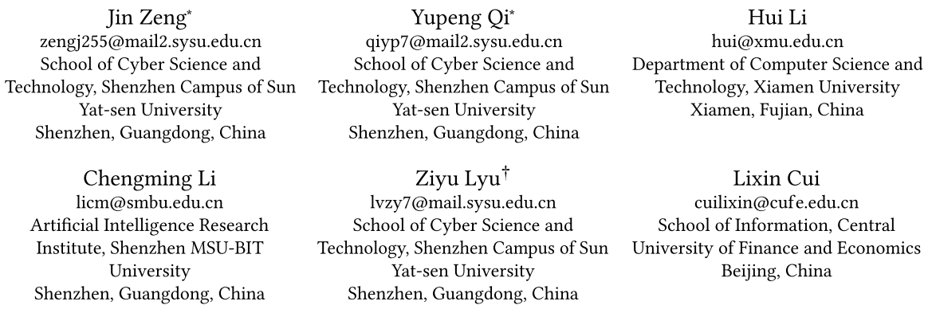





ATAI
Advanced Technique of Artificial Intelligence
ATAI
ChongqingUniversity _{AdvancedTechniqueof}
of Technology Artificial Intelligence
Chongqing University of
Technology
Chongqing University ^{ATAI}
_{of Technology} Advanced Techniqueof
Artificial Intelligence
Chongqing University of Technology
Chongqing University of Technology
RAIE: Region-Aware Incremental Preference Editing with LoRA
for LLM-based Recommendation
Code:https://github.com/fengaogao/RAIE
—— WWW_2026
Reported by Long Zhang
1

Slide 2
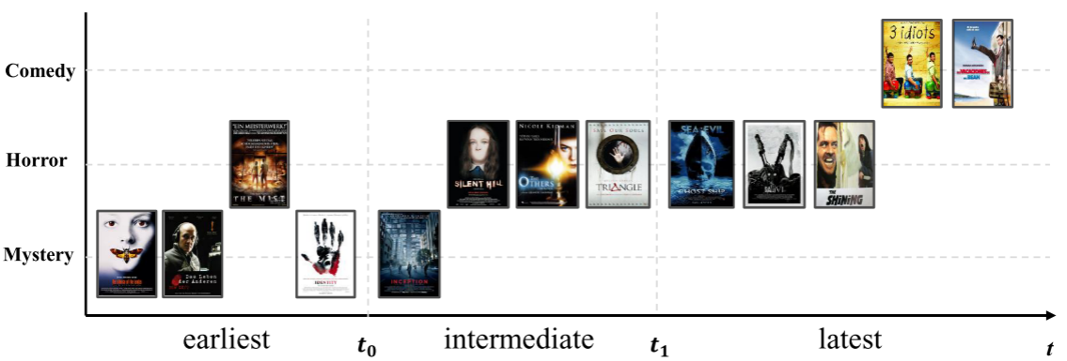
ATAI
Advanced Technique of Artificial Intelligence
ATAI
ChongqingUniversity _{AdvancedTechniqueof}
of Technology Artificial Intelligence
Chongqing University of
Technology
Chongqing University ^{ATAI}
_{of Technology} Advanced Techniqueof
Artificial Intelligence
Chongqing University of Technology
Chongqing University of Technology
Motivation
(1) imbalanced update granularity, where global updates perturb behaviors unrelated to the target while pointwise edits fail to capture broader preference shifts.
(2) unstable incremental updates, where repeated edits interfere with prior adaptations, leading to catastrophic forgetting and inconsistent recommendations.

Slide 3
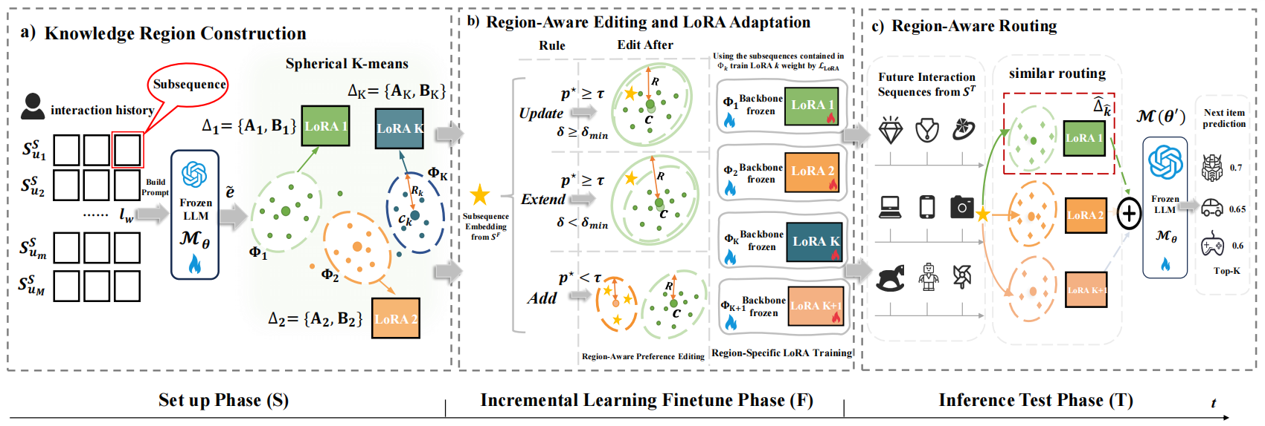
ATAI
Advanced Technique of Artificial Intelligence
ATAI
ChongqingUniversity _{AdvancedTechniqueof}
of Technology Artificial Intelligence
Chongqing University of
Technology
Chongqing University ^{ATAI}
_{of Technology} Advanced Techniqueof
Artificial Intelligence
Chongqing University of Technology
Chongqing University of Technology
Method

Slide 4
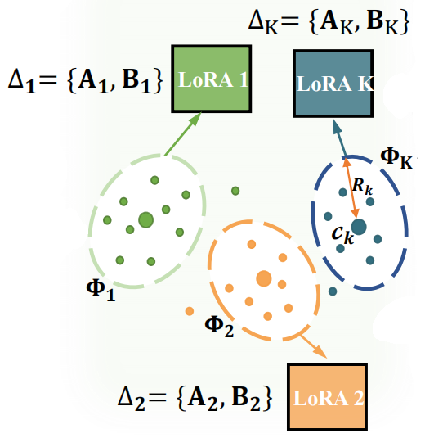
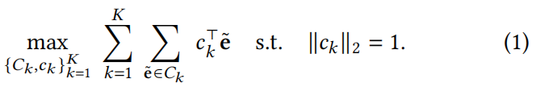

ATAI
Advanced Technique of Artificial Intelligence
ATAI
ChongqingUniversity _{AdvancedTechniqueof}
of Technology Artificial Intelligence
Chongqing University of
Technology
Chongqing University ^{ATAI}
_{of Technology} Advanced Techniqueof
Artificial Intelligence
Chongqing University of Technology
Chongqing University of Technology
Method

Slide 5
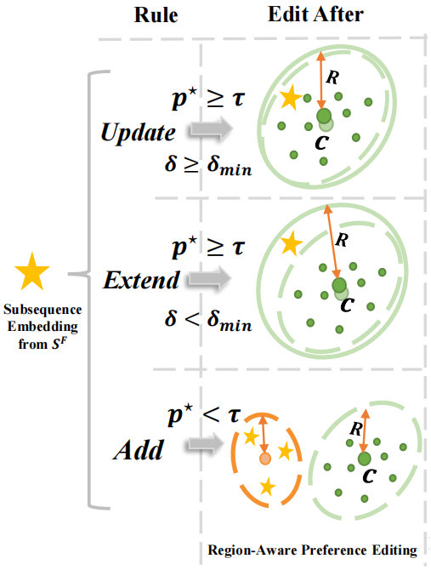

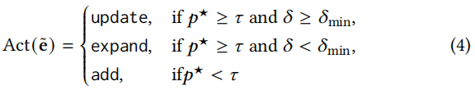
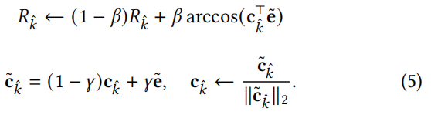
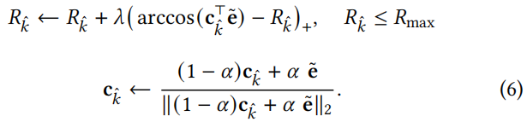
ATAI
Advanced Technique of Artificial Intelligence
ATAI
ChongqingUniversity _{AdvancedTechniqueof}
of Technology Artificial Intelligence
Chongqing University of
Technology
Chongqing University ^{ATAI}
_{of Technology} Advanced Techniqueof
Artificial Intelligence
Chongqing University of Technology
Chongqing University of Technology
Method

Slide 6




ATAI
Advanced Technique of Artificial Intelligence
ATAI
ChongqingUniversity _{AdvancedTechniqueof}
of Technology Artificial Intelligence
Chongqing University of
Technology
Chongqing University ^{ATAI}
_{of Technology} Advanced Techniqueof
Artificial Intelligence
Chongqing University of Technology
Chongqing University of Technology
Method

Slide 7
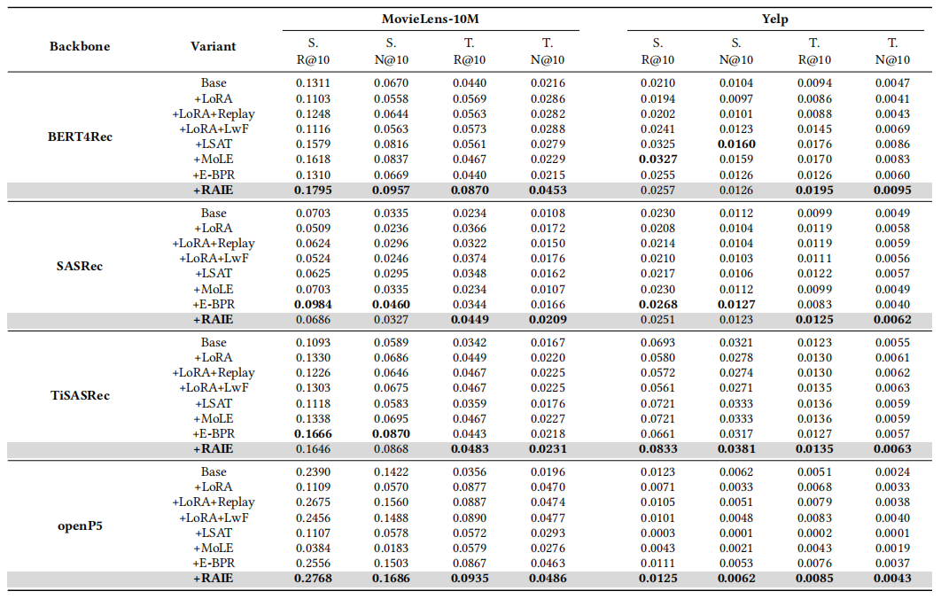
ATAI
Advanced Technique of Artificial Intelligence
ATAI
ChongqingUniversity _{AdvancedTechniqueof}
of Technology Artificial Intelligence
Chongqing University of
Technology
Chongqing University ^{ATAI}
_{of Technology} Advanced Techniqueof
Artificial Intelligence
Chongqing University of Technology
Chongqing University of Technology
Experiments

Slide 8
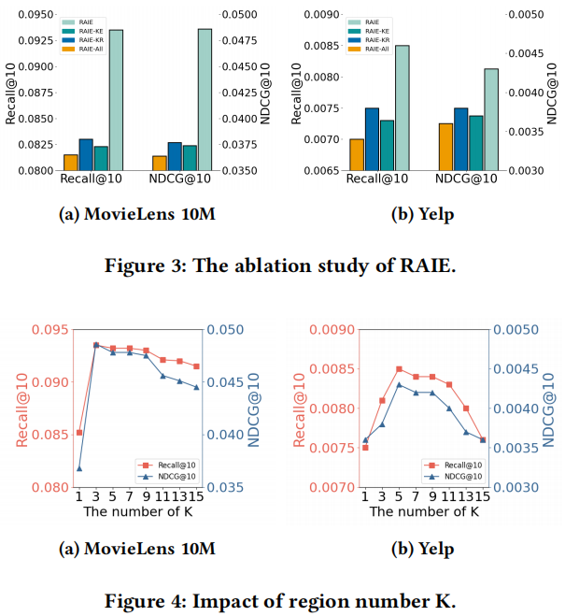
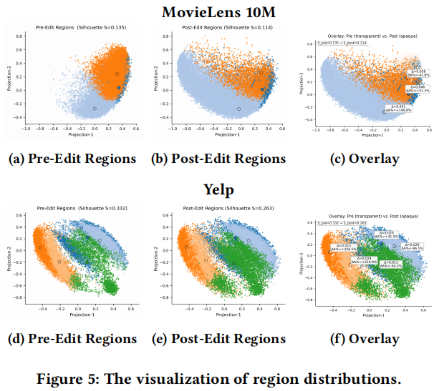
ATAI
Advanced Technique of Artificial Intelligence
ATAI
ChongqingUniversity _{AdvancedTechniqueof}
of Technology Artificial Intelligence
Chongqing University of
Technology
Chongqing University ^{ATAI}
_{of Technology} Advanced Techniqueof
Artificial Intelligence
Chongqing University of Technology
Chongqing University of Technology
Experiments

Slide 9


ATAI
Advanced Technique of Artificial Intelligence
ATAI
ChongqingUniversity _{AdvancedTechniqueof}
of Technology Artificial Intelligence
Chongqing University of
Technology
Chongqing University ^{ATAI}
_{of Technology} Advanced Techniqueof
Artificial Intelligence
Chongqing University of Technology
Chongqing University of Technology
Thanks!

